Slide 1
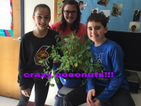
The Effects of Temperature on Plant Growth
By: Emmie, Michael, and Michayla

Slide 2
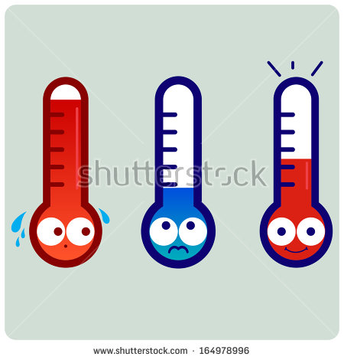
Introduction
For our experiments we decided to study the effects of temperature on plant growth. This is such an interesting topic because climates are changing rapidly, and people need to know the best climates/temperatures to grow in. We hope that we could improve agriculture and farming with our studies.

Slide 3
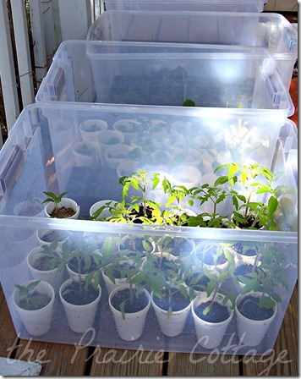
Methods
Grew for 22 days
2 radish seeds in each of the 12 cups
Divided cups equally into 3 bins Warm, Cold, Controlled
Cold bin- ice packs were placed inside to keep the soil cold and it was insulated on the outside
Warm bin- Bright light placed underneath, the cap was also put on this bin so the bin would work as a greenhouse
Watered plants on days they needed water ( radishes always need to stay damp)
Height was measured daily

Slide 4
Results
Cold bin- grew slowly and healthy.
Warm bin- grew tallest, fastest, and healthy.
Controlled bin- grew fast, but most plants in this bin died.

Slide 5
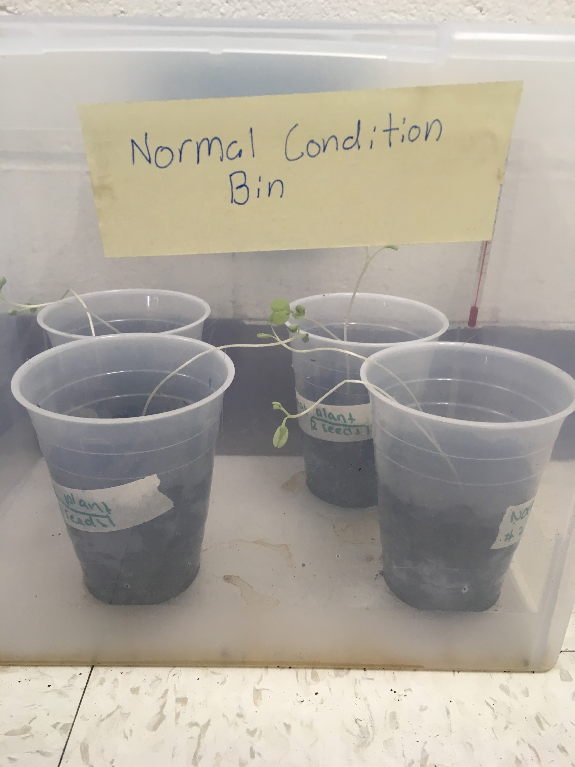
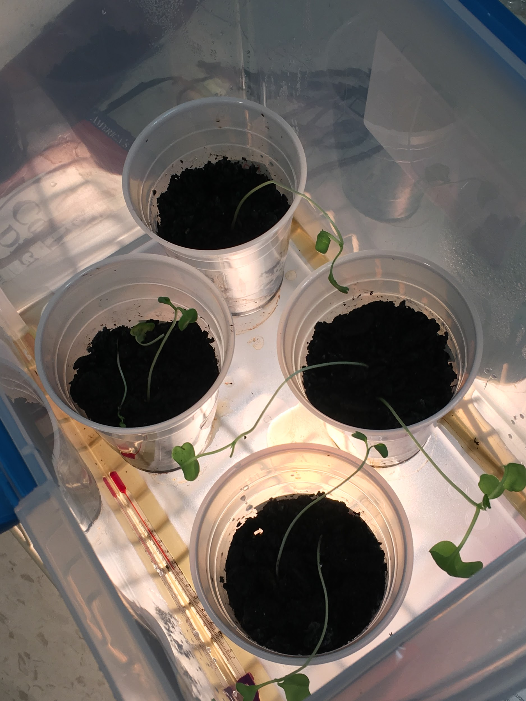
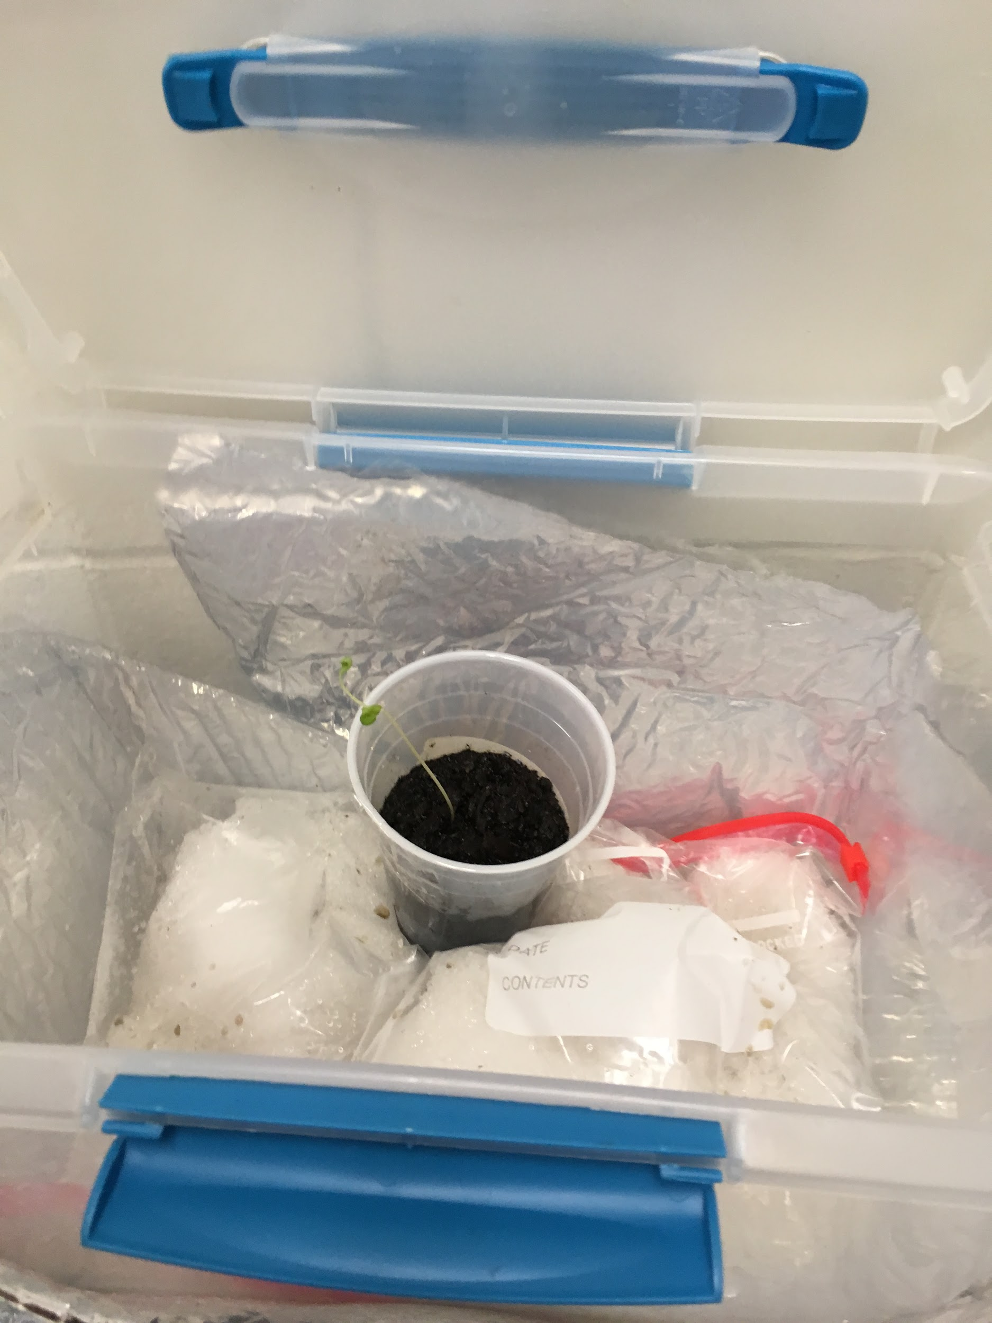
Reasoning For Outcome of Our Experiment
Warm
Cold Bin- the soil was to cold which slowed which could have caused slower plant functions resulting in fewer leaves, and less height.
Warm Bin- moisture in the warm bin kept soil at perfect dampness, allowing the plants to grow super tall with many leaves.
Controlled bin possibly did not get enough sunlight resulting in plant deaths.
Control
Cold

Slide 6
Hypothesis: Cold temperature will slow down growth; warm temperature will wilt plants, and the Controlled temperature will grow the plants steadily.
Partially supported:
The cold temperature slowed down growth.
Warm temperature kept plants healthy
Controlled plants wilted
Warm Cold

Slide 7
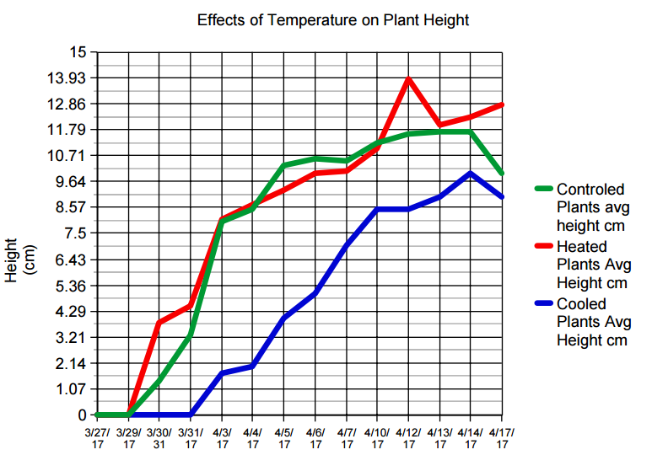
Graph of Daily Growth
This graph describes the effects of temperature on our plants average growth per day. As you can see the warm bin plants ended up the tallest followed by the controlled plants and finally the cold plants.

Slide 8
Work Cited
ImageSlide1https://www.google.com/url?sa=i&rct=j&q=&esrc=s&source=images&cd=&cad=rja&uact=8&ved=0ahUKEwjApLq7w7PTAhVM7BQKHa3WDxAQjRwIBw&url=https%3A%2F%2Fwww.tes.com%2Flessons%2FeSpdxqelrpSqmg%2Fsuper-awsome-climate-and-temperature&psig=AFQjCNGuzFfQu8i0zMDBh2fd7YLLebdlzQ&ust=1492794619395332
ImageSlide2https://www.google.com/url?sa=i&rct=j&q=&esrc=s&source=images&cd=&cad=rja&uact=8&ved=0ahUKEwjuqLyMx7PTAhVDxRQKHfroD3IQjRwIBw&url=https%3A%2F%2Fwww.pinterest.com%2Fpin%2F287948969900325934%2F&psig=AFQjCNFdZKwLJgHtcS2oi-Y4QjBc8ckGpg&ust=1492795572264941
ImageSlide4

