Slide 1
The Effects Of Pollination
BY: Sven, Noah, Adrian, Eric

Slide 2
Benefits of pollination
The main goal for pollination is to create offspring for the next generation
The way they do that is by creating seeds
Genetic diversity helps in this because if a disease starts to occur, then there will be a higher survival rate because of the variety of species. Also, having more variety in species will create more offspring which build the environment

Slide 3
The importance of cross pollination
Cross pollination is a significantly important form on pollination because it is the most effective way of reproducing.
This also helps create genetic diversity within the plants which will further on help their resistance to getting a disease.
We should protect them because it is what will create a better stable and working environment.

Slide 4
Creating your plant
1: Put soil into 2 cups for your group.
2: Add Brassica seeds to both pots
3: Water the plants
4: Place them in sunlight 24/7
5: Observe and collect data from each day. Note the growing speed.

Slide 5
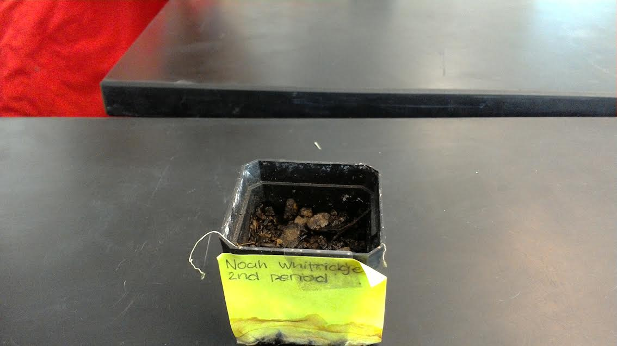
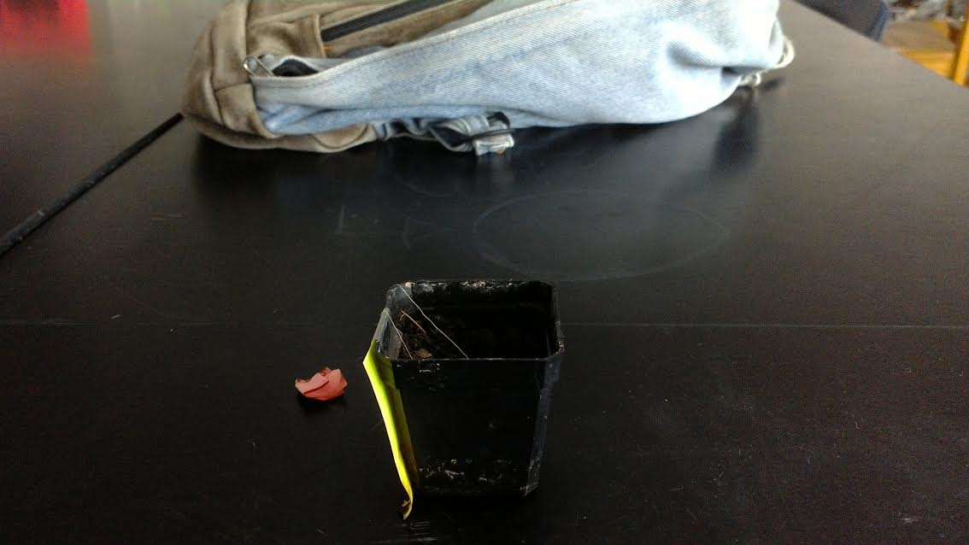
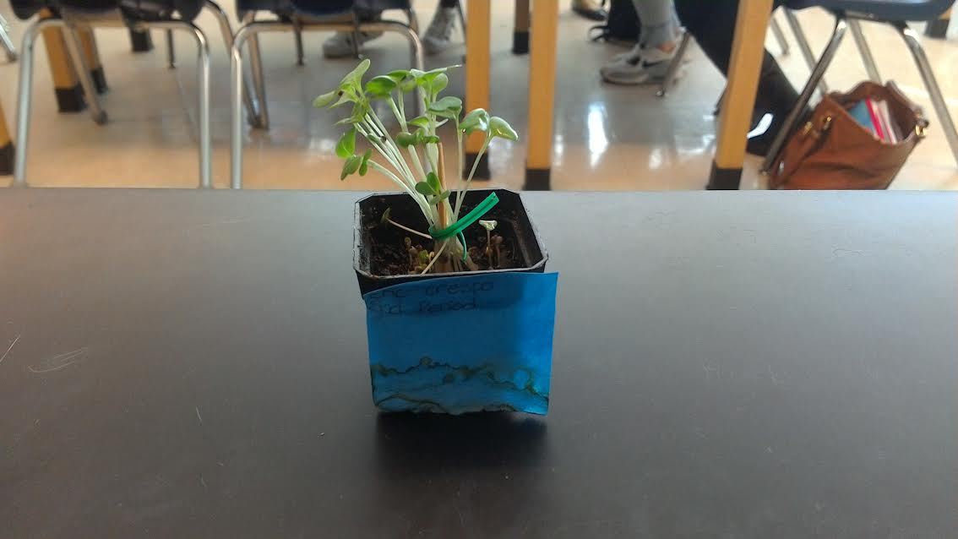
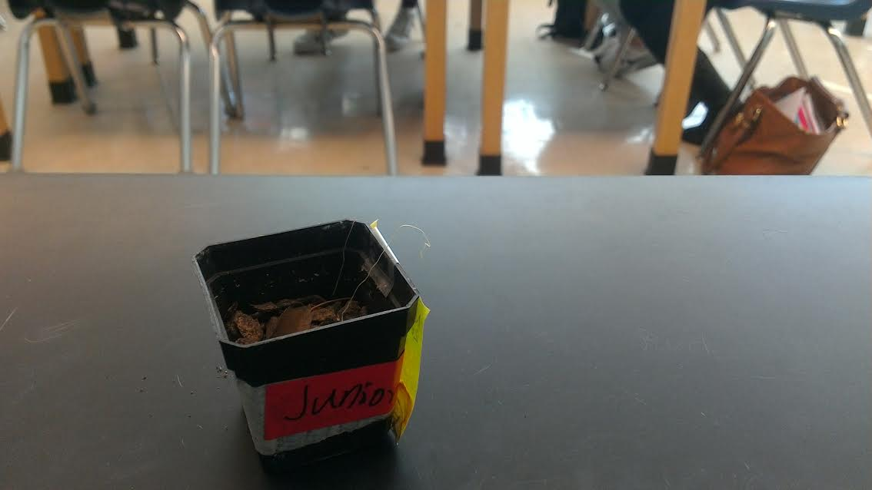
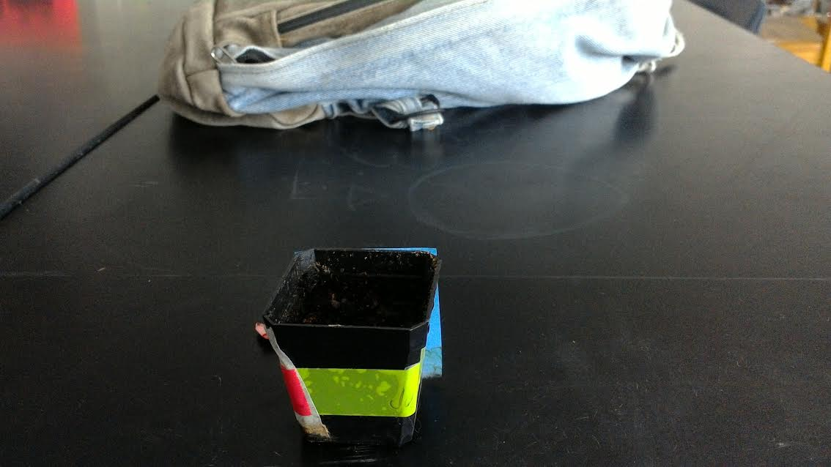
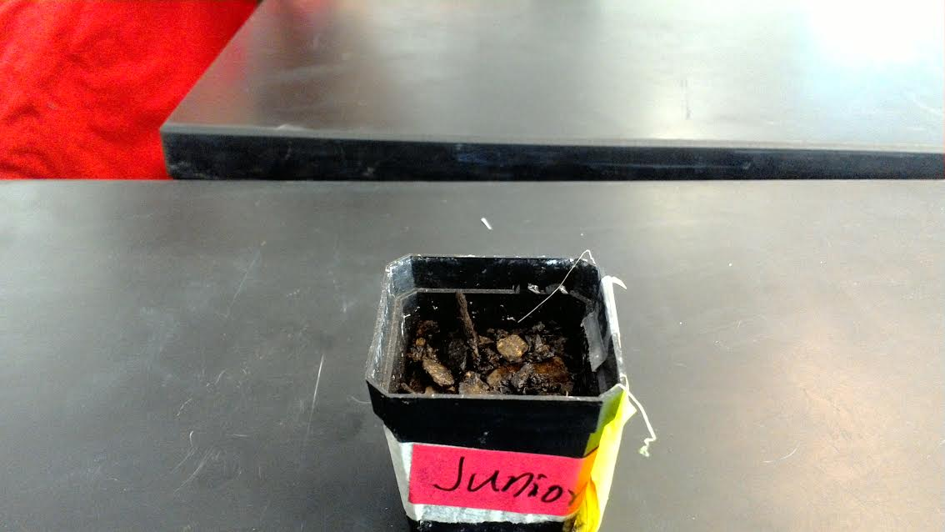
Data

Slide 6
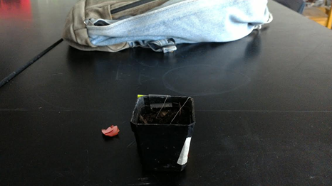
Data Analysis
From this data we can conclude that there was a reaction that we did not expect. Most of the plants did not even grow to our expectations.
From these plants, we can
also interpret that it was either not planted correctly or there was a different reaction that the seeds had to the water.

Slide 7
Data analysis continued
However, one plant did have a good reaction. This plant
Sprouted well which resulted in a healthy flower.

Slide 8
conclusion
From this data we can conclude that not all plants will grow the same way as others. It depends on how they are planted, the amount of sunlight they get, and how often they are watered. There are many other factors that can interpret this like the size of the seed and the quality of the soil as well.

Slide 9
Further study
Our hypothesis was wrong when our data results were shown. We expected the plants to have a steady growth and will expand daily. This was wrong because only one grew and the others suffered. To protect your plants from dying, you should always keep them in sunlight 24/7 and make sure they are well watered and kept in good care.

